Slide 1
Data Professional Breakdown Survey
Using Microsoft power bi

Slide 2
Introduction
A "Data Professional Breakdown Dashboard" is a visual representation of data gathered from surveys or other sources, analyzing various aspects of data professional’s experiences, such as demographics, work satisfaction and career preferences.

Slide 3
Methodology
In Power BI – upload data file: Get data.
Perform ETL.
Create dashboard.

Slide 4
Transforming Data
Remove the empty and unnecessary columns.
For columns like job title, job industry, country and favorite programming language: split the others option by using split column using delimiters.
This will remove the multiple options in others to simply others for easier analysis.
Delete the columns with options of others as we will not use them for analysis.
For the column current yearly salary, the salary bracket is given. For analysis we will take the average salary for simplifying analysis.
Create a duplicate column for current yearly salary.

Slide 5
Split the duplicate column using split column: digit to non digit.
Delete the column with only k as value.
For column with k and – remove them using replace value.
The option for + replace it with 225.
Change the data type as whole number for both the columns.
Add a column as average salary using custom column.
Remove the splitted columns for current yearly salary and reorder the average salary column.
Check and change the data types for the columns.
Close and apply the transformations in power query editor.

Slide 6
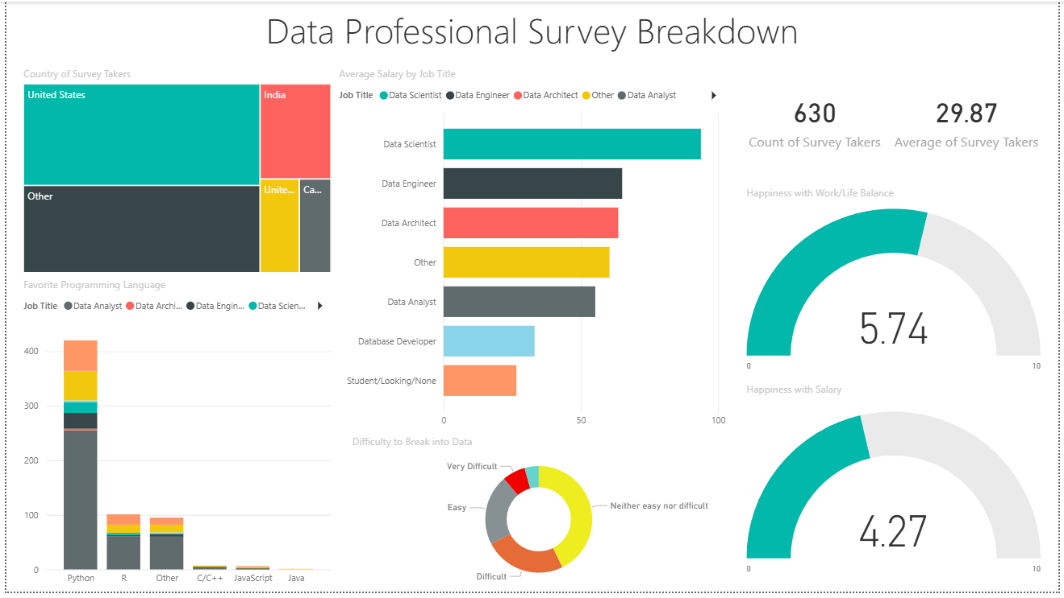
Dashboard

